Slide 1
BITCOIN PRICE PREDICTION USING DEEP LEARNING
Anagha c kandathikudiyil
ROLL NO: 15
S4 MCA A

Slide 2
CONTENT
1. RELEVANCE OF TOPIC
2. PROJECT DESCRIPTION
3. OBJECTIVES OF STUDY
4. EXISTING AND PROPOSED SYSTEM
5. MODULES IDENTIFIED
6. INPUT/ OUTPUT CODE DESCRIPTION
7. DESIGN AND IMPLEMENTATION DETAILS

Slide 3
RELEVANCE OF TOPIC
Bitcoin is a crypto currency which is used worldwide for digital payment or simply for investment purposes.
The price of Bitcoin does not depend on the business events or government which changes its value in every second.
Thus, it is necessary to leverage machine learning technology to predict the price of Bitcoin.

Slide 4
PROJECT DESCRIPTION
The project focuses on the accurate prediction of Bitcoin price using a simple Long Short Term Memory(LSTM) model.
Based on the predicted price rate we can decide either to sell, buy or to hold the stock.
A demostration of the Bitcoin trading is also done in this project.

Slide 5
OBJECTIVES OF STUDY
To develop a webpage which will predict the bitcoin prices for upcoming 10 days.
Allow the investors to invest wisely in bitcoin trading as the prices of bitcoin have gone up.
To make use of machine learning algorithms to increase the accuracy of Bitcoin price prediction.

Slide 6
EXISTING AND PROPOSED SYSTEM
EXISTING SYSTEM
Existing system predict trend of the stock.
They perform both short term predictions (day or week predictions)
and also long-term predictions (months).
It is found that the latter produced better results with 79% accuracy.
Drawbacks:
Instead of directly forecasting the future price of the stock,
it analyzed trend only.
Low accuracy.

Slide 7
EXISTING AND PROPOSED SYSTEM
PROPOSED SYSTEM
Proposed System uses deep learning mechanism such as LSTM for forecasting bitcoin price.
`It avoids the back propagation error from vanishing or exploding.
It provides efficient and accurate results than other models.

Slide 8
MODULES IDENTIFIED
PRICE FORECAST
Price forecast is done for coming 10 days.
The result is compared with the score value to identify the accuracy value and plotted.
BITCOIN TRADING
Customer Registration
Bitcoin Purchase
Bitcoin Sell

Slide 9
ALGORITHM
LSTM- Long Short Term Memory
LSTM can store past important information and forget the information that is not.
LSTM has three gates:
The input gate: The input gate adds information to the cell state
The forget gate: It removes the information that is no longer required by the model,
The output gate: Output Gate at LSTM selects the information to be shown as output.

Slide 10
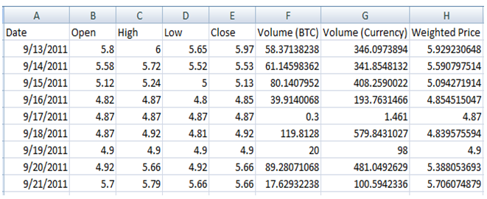
DATASET
Variable name | Short description
Date | Trading Date
Open | Bitcoin Open price for particular time
High | Bitcoin High price achieved for particular time
Low | Bitcoin Low price achieved for particular time
Close | Bitcoin Close price for particular time
Volume (BTC) | Coin volume traded
Volume (Currency) | Coin value traded
Weighted price | Price per coin traded

Slide 11
FRONT END/BACK END/ TOOLS
HTML : The HyperText Markup Language, or HTML is the standard markup language for documents designed to be displayed in a web browser. It can be assisted by technologies such as Cascading Style Sheets and scripting languages such as JavaScript.
CSS : Cascading Style Sheets is a style sheet language used for describing the presentation of a document written in a markup language such as HTML.
Python : Python is a computer programming language often used to build websites and software, automate tasks, and conduct data analysis.

Slide 12

SCREENSHOTS
HOME PAGE

Slide 13
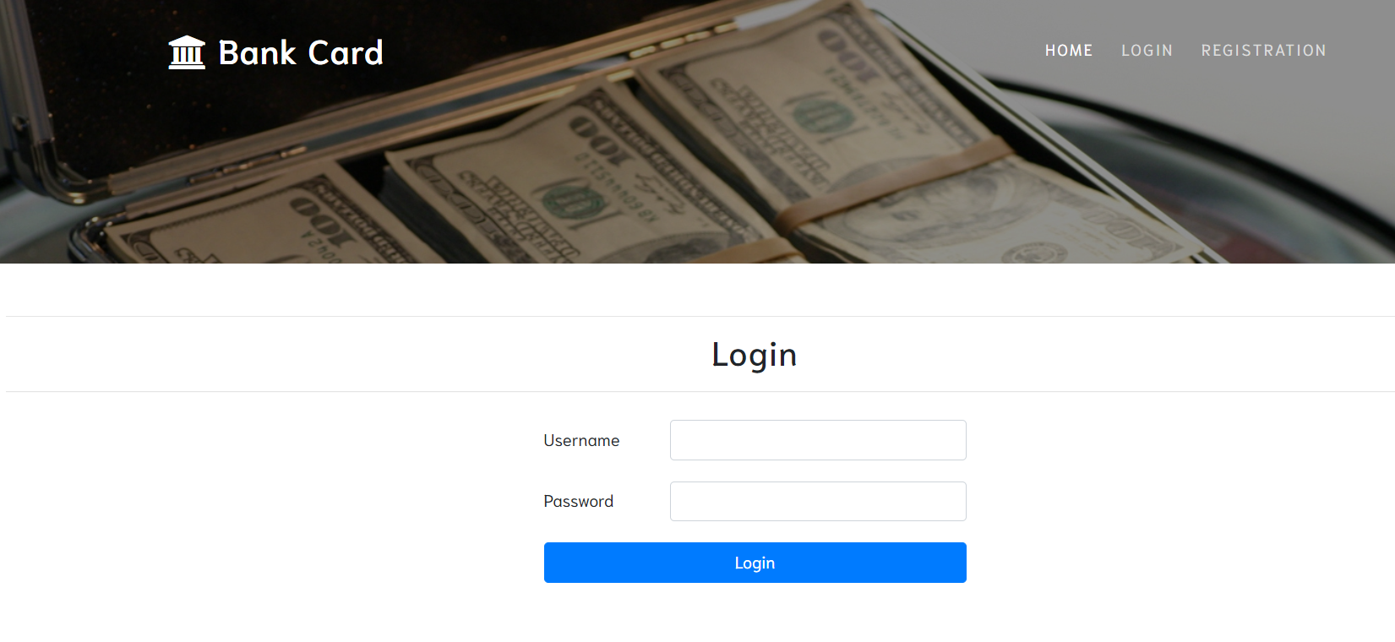
LOGIN PAGE

Slide 14
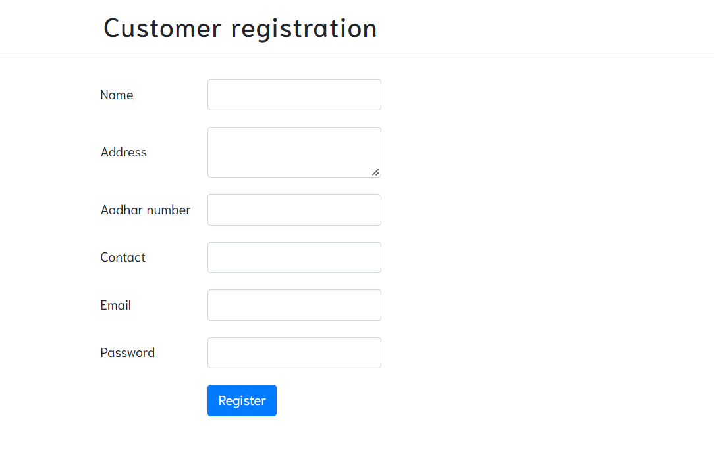

Slide 15
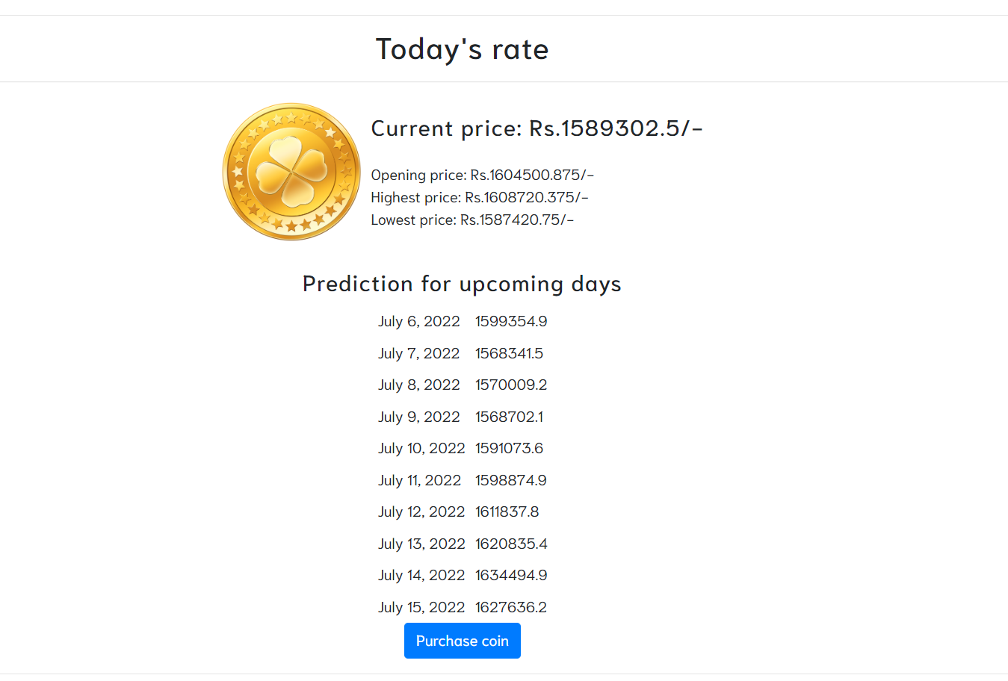
PRICE PREDICTION

Slide 16
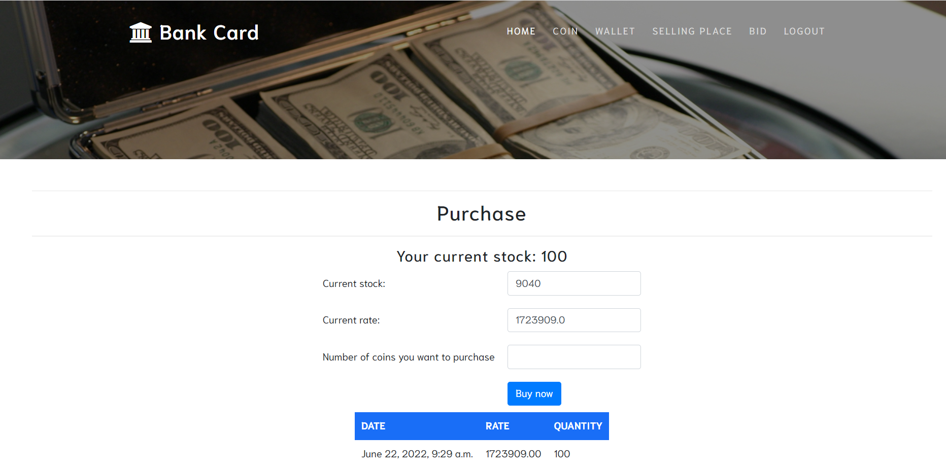
BITCOIN PURCHASE

Slide 17
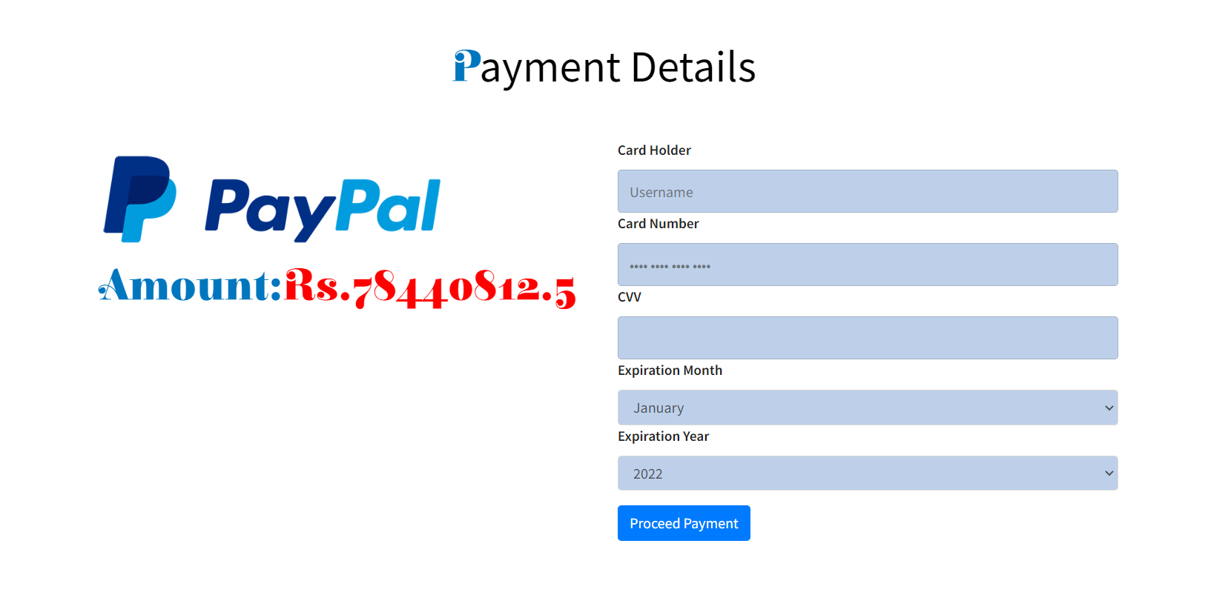
PAYMENT

Slide 18
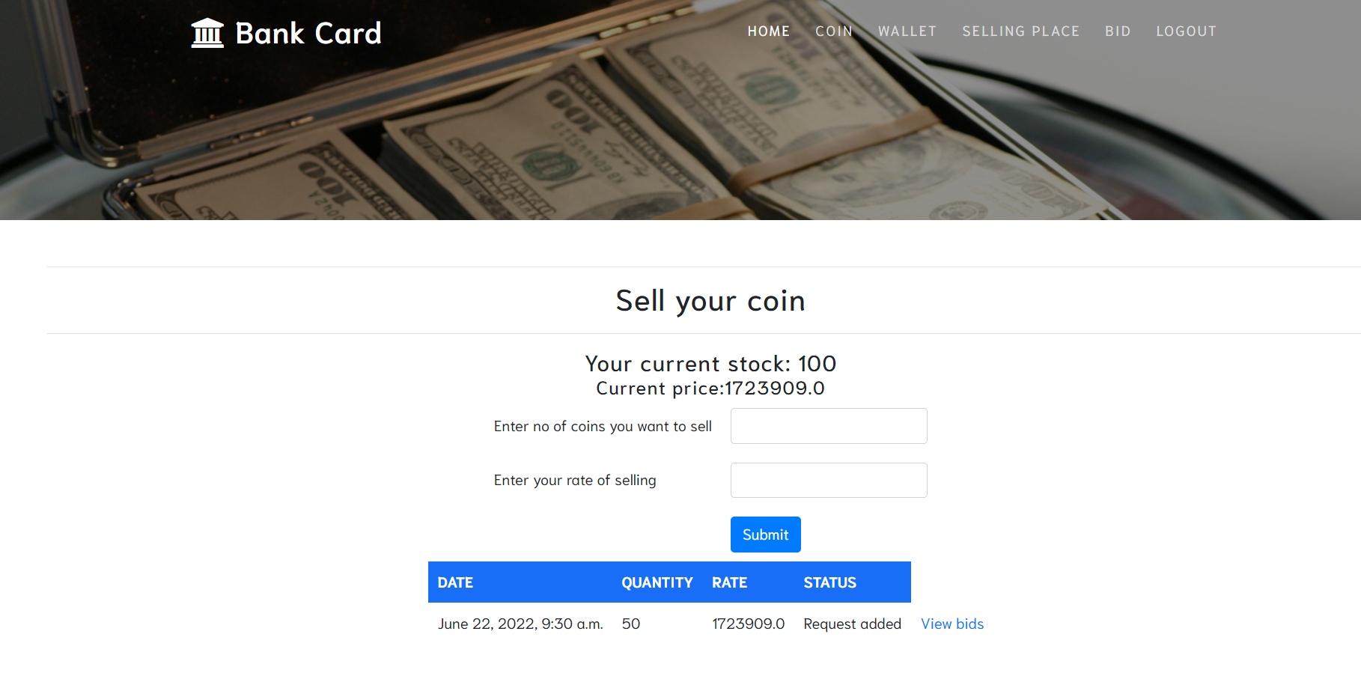
SELL BITCOIN

Slide 19


